Slide 1


WELCOME
TO
SDC-SB
SEMINAR

Slide 2
SKILL DEVELOPMENT CELL
STUDENT BRANCH

Slide 3
SKILL DEVELOPMENT CELL-SB has been
started in the year 2021 in the month of August, with a motive
to encourage students to learn about the latest technologies.
SDC provides student members a networking opportunity to
meet and learn from fellow students as well as faculty members
and professionals in the field to share their interests, future
professions and ideas in addition to improving their soft and
hard skills.

Slide 4
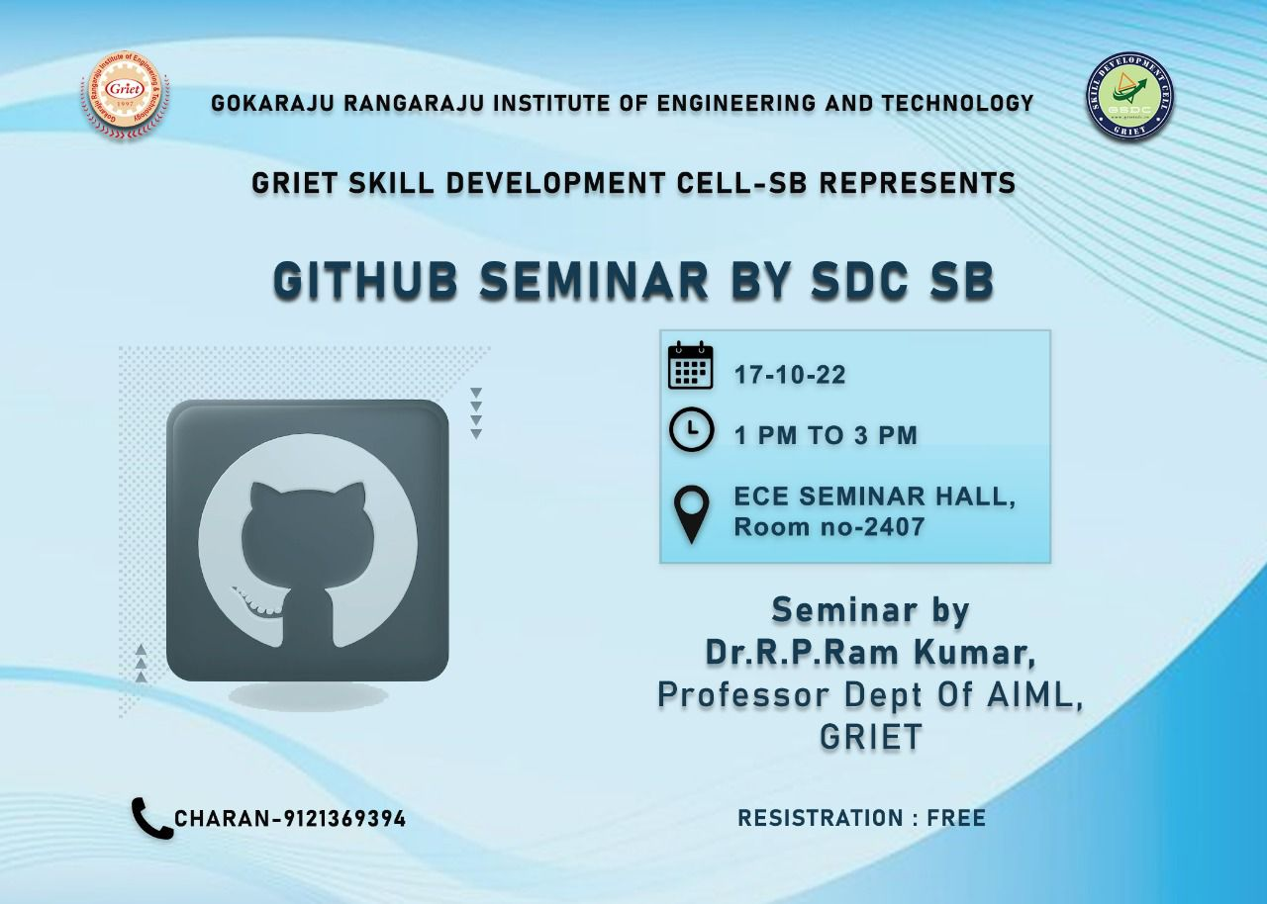

Slide 5
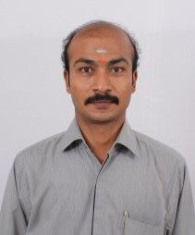
OUR SPEAKER
Dr. R.P Ram Kumar
(Professor, Dept of AIML, GRIET)
Doctorate of Philosophy in Computer Science and Engineering.
Master of Engineering (Computer Science and Engineering
Bachelor of Engineering (Computer Science and Engineering)
Diploma in Electrical and Electronics Engineering

Slide 6
THANK YOU

